Slide 1
@PhysicsNews

Slide 2
Some key stats on
Physics-based Businesses
Gross Value Add (GVA)
  UK £177bn 10% GDP
  Ireland €23bn 26% GDP
Employment
  UK >2 million 6.7% of workforce
  Ireland 160,000 8.6% of workforce
Productivity
  UK £88,114 2.3x average
  Ireland €138,273 3x average

Slide 3
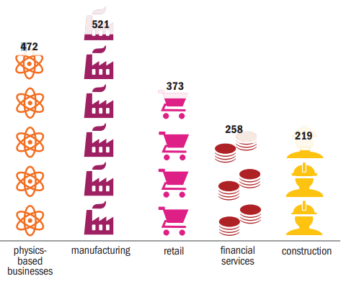
Turnover £bn

Slide 4
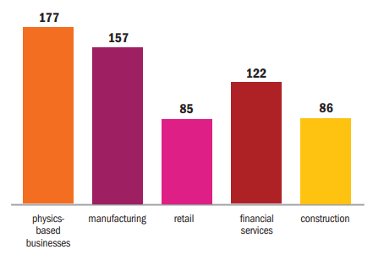
GVA £bn

Slide 5
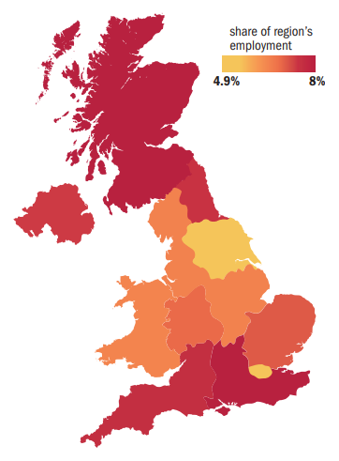

Slide 6
Our fastest growing areas
Quantum and photonics - sensors and imaging
High-value manufacturing
Compound semiconductors
Renewables
New materials
Satellite platforms and applications
Medical physics
Bio physics – neurology and cancer

Slide 7
Investment in R&D
Total R&D Expenditure in UK is £34.8bn
This is 1.7% GDP – lowest in the G7 and has been constant over the recent decade(s)
Almost two-thirds of this comes from the private sector
Government has set a target of 2.4% GDP by 2027 requiring unprecedented increases in both public and private sector funding

Slide 8
International Comparators

Slide 9
The Industrial Strategy: transforming the UK into the world’s most innovative economy by 2030
Artificial Intelligence and data
Ageing society
Clean growth
Future of mobility
Notes:
Catapults – skills, tech and capability clusters
Loans – Innovate UK
Gov Structures - R&D tax credits

Slide 10
Sector deals relevant to physics-based businesses
AI and big data
Automotive
Aerospace
Defence
Creative Industries
Nuclear
Offshore Wind
Rail
Notes:
SMEs – engine room for growth
Photonics vs life sciences – enabling technologies
Strong innovation but loosing IP at critical growth stage – impatient angel investors; loss of public labs

Slide 11
The foundations for boosting productivity and economic growth across the UK
Business environment
Places
Ideas and innovation
People
Infrastructure

Slide 12
The IOP’s programme of support
Business Advisory Group
Business, Innovation and Growth Group
Physics Insights and Policy programme
Annual Business Conference
Briefings for start-ups
Business Awards
Technician and Apprenticeship Awards
Network of Incubator Space

