Slide 1
Membership matters
Nithaya Chetty
Vice President – New Members
02 October 2019
C&CC Meeting, London, England

Slide 2
Action items from previous C&CC meeting
A decadal strategy for attracting new members and retaining old members was presented at previous C&CC meeting
Forms basis of agenda for New Members portfolio
Various action items are continuously being acted upon
A Memorandum of Understanding template has been drafted

Slide 3
New members (subject to approval at next GA)
Jordan – joined in July 2018, MoU needs to be signed
Egypt – MoU was signed in March 2019
Michel to visit in December for high-level discussions on Egypt’s re-admission
Uruguay – MoU was signed in April 2019
Recommend visit by President-(elect)²
Bulgaria – MoU will be signed in December 2019
Michel to visit in December for signing of MoU
Address International Conference on "Research Infrastructures of the Future – synergies, sustainability, smart specialization and social impact ", 10 and 11 December 2019, National Palace of Culture, Sofia, Bulgaria.

Slide 4
On-going engagements
Ethiopia – working with EPSNA and EPS
Pakistan – challenges
Joined in 1951, re-admitted in 2017
Adhering body to the IUPAP is the National Center of Physics (NCP)
Liaison has been Prof Anisa Qamar from the Univ of Peshawar
Various other countries
Still awaiting feedback from some C&CC members
Engagements though from C13, C14, WG5
All commission chairs have been requested to help lead membership initiatives

Slide 5
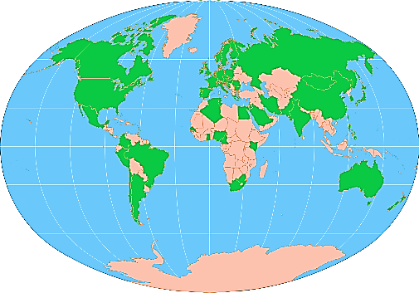
Current standings
57 [56] members of the Union
Approximately 76.79% (43 [42] members) are considered to be very secure
7.14% (4 [2] members) moderately secure
16.07% (9 [12] members) precarious in the membership of the Union
Over the past decade, 14 [11] members entered the Union and subsequently 3 [3] of these members exited the Union
13 member nations in 1922 and 57 member nations in 2019

Slide 6
Way forward
There is a need for strong administrative support
Face-to-face meetings, signing of MoU important to deepen commitment
Scientific diplomacy
Maintain apolitical stance
New members should be afforded the opportunity to nominate members to commissions, working groups
Important to demonstrate immediate RoI

Slide 7
Way forward
Extensively market and publicize the Union
Especially to non-member countries
Involve non-member physicists in affairs of the Union (potential champions)
What are the benefits for individual membership? (local perspective)
Why does IUPAP wish to expand its membership? (global perspective)

Slide 8
Way forward
IUPAP100 is an important opportunity to recruit new members
IYBSD critically important for building physics bridges between the developed world and the developing world
Developing world important recruiting ground for new members
Involve more young people in the affairs of the Union
Our future depends on it

Slide 9
Final comments
In order for IUPAP to make a step increase in its membership, we need to better
Understand the new circumstances that science finds itself in the 21st century
New opportunities for physics
Better articulate how IUPAP is the lead organisation for addressing these challenges

Slide 10
Physics rankings
The SCImago Journal & Country Rank is a publicly available portal that includes the journals and country scientific indicators developed from the information contained in the Scopus®
SCImago is a research group from the Consejo Superior de Investigaciones Científicas (CSIC), University of Granada.

