Slide 1
WG2 Communication in Physics
Jens Vigen

Slide 2
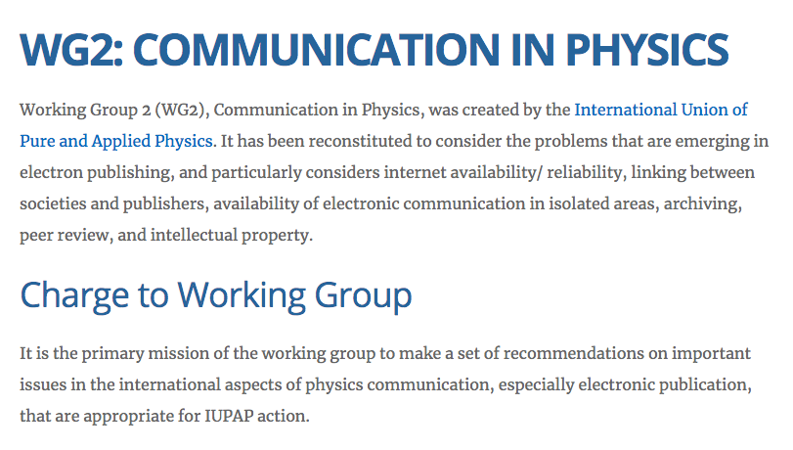
WG dormant since Oct. 2015 Being revived 2019 with new membership

Slide 3
Current membership Confirmed commitment in end of May 2019
Michael Thoennessen, APS Editor in Chief
Replacing Daniel T. Kulp (“Placeholder” for ex-chair Gene Sprouse)
Mitsuaki Nozaki, KEK International Office
Li Lu (tmp., new election Sep.), Chinese Physical Society
Xavier Bouju, French Physical Society
Jens Vigen, CERN (Chair)
Received suggestions for replacements of members (Enrique Canessa, Sergio M Rezende and Nicola Gulley) who have stepped down following change of functions

Slide 4
Suggested WG2 roadmap
Q4-19: Prepare an updated mandate
Q4-19: Re-establish the full group
Q1-20 Study the “open” landscape
Q2-20: Work on set of recommendations
Q3-20: Supply recommendations to C&CC

Slide 5
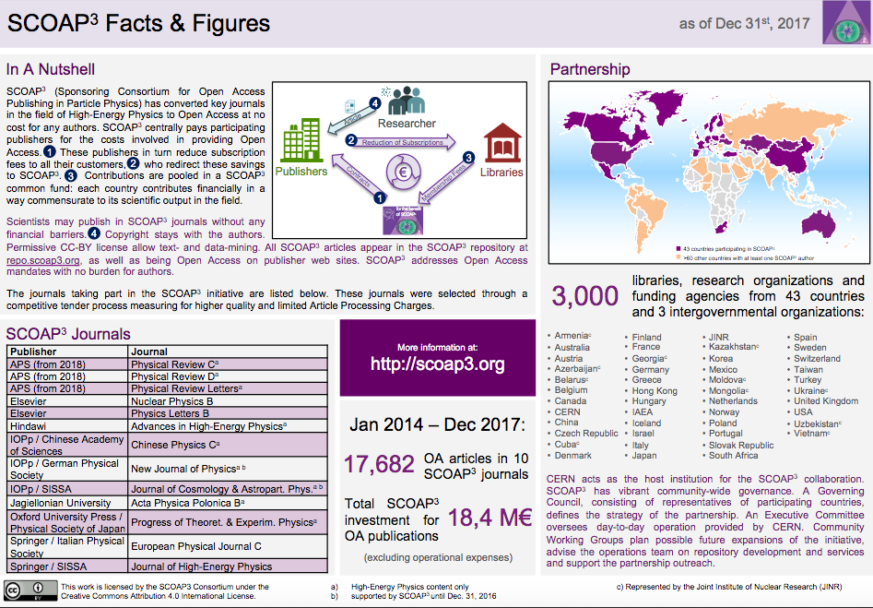
SCOAP³ – phase 3 in preparation 2014–2016, 2017–2019, 2020–2022
SCOAP³ has published 30428 Open Access articles since 2014

Slide 6
Open access outside HEP
The SCOAP³-model is HEP-specific
One size does not fit all …
Publishers (including society publishers) often have strong commercial interest - typically diagonal opposite of the librarians' interests, while scientists are becoming more and more pro OA (often influenced by their funders)
Future perspectives:
We will continue to be ”slaves” of the Impact Factor
We will publish on arXiv, or something similar, and journals will disappear
We will reach a paradigm shift in scholarly communication

Slide 7
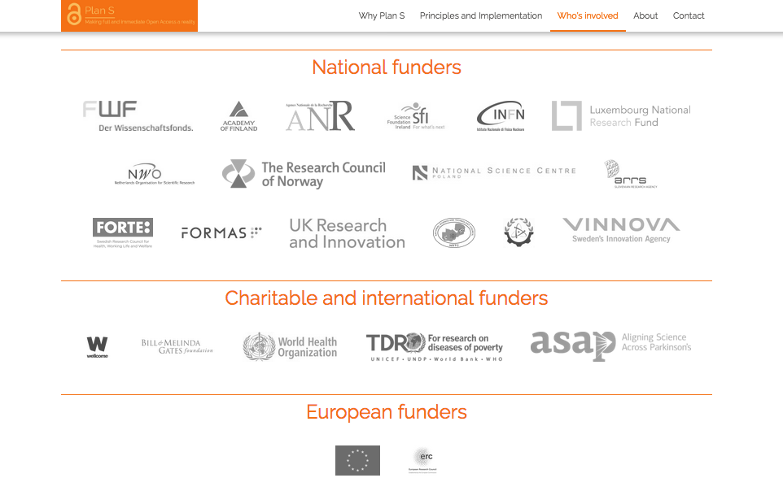
Funders that have endorsed Plan S

Slide 8
Funders that have endorsed Plan S

Slide 9
The Plan S principles
With effect from 2021, all scholarly publications on the results from research funded by public or private grants provided by national, regional and international research councils and funding bodies, must be published in Open Access Journals, on Open Access Platforms, or made immediately available through Open Access Repositories without embargo.
https://www.coalition-s.org/principles-and-implementation/

Slide 10
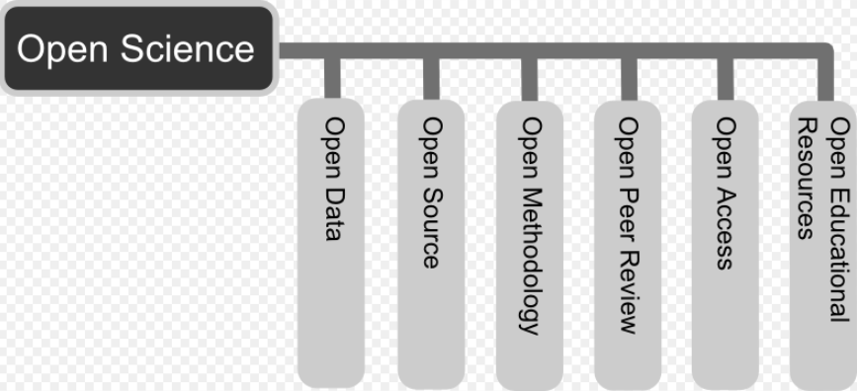
Open science
An accelerating concept, but …
Potentially hampered by national interests preventing general access to research data
Often driven by funders and their data preservation plans
Lack of capacity for data curation
And who shall run the open-data repositories?
… all this, while maintaining science credibility.

Slide 11
Which position shall IUPAP take to “open”?
IUPAP must defend physicists’ right to be part of “open”
There is no question—technology leads to ”open”
The days of the toll barriers are passed (Sci-Hub)
Not publishing the data/software will in the future be as unthinkable as not publishing the article today
WG2: advice on the optimal way to “open”
Allow for different routes
Avoid global divide
Which part of “open”?
open access,
open science,
and maybe open innovation (less sure if this falls under WG2—different people/skills)

