Slide 1
2016 IUPAP C&CC Meeting in Taipei
ICO
Evolving toward an
ICSU Union
Yasuhiko Arakawa
AC1 Chair
www.e-ico.org

Slide 2
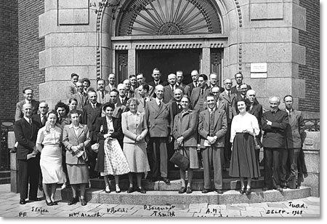
History
ICO was formed in 1947
IUPAP approved the appointment of a Preparatory Committee to consider the formation of an ICO
ICO-1
1948 The Netherlands
www.e-ico.org

Slide 3
ICO Leadership
ICO Bureau (2014-2017)
Executive Board:
President: Yasuhiko Arakawa, Japan
Past-President: Duncan T. Moore, USA
Secretary General: Angela M. Guzmán, Colombia/USA
Associate Secretary: Gert von Bally, Germany
Treasurer: James A. Harrington, USA
Elected Vice-Presidents:
John Harvey, New Zealand, elected from industry
Frank Holler, Germany, elected from industry
Humberto Michinel, Spain
Joseph Niemala, Italy/USA
Roberta Ramponi, Italy
Seung-Han Park, South Korea
Jakub Zakrzewski, Poland
Mourad Zghal, Tunisia
Appointed Vice-Presidents:
Kent D. Choquette, IEEE Photonics Society, USA
John C. Howell, OSA, USA
Stephen Morgan, OWLS, UK
Eric Rosas, RIAO, Mexico
Paul Urbach, EOS, The Netherlands
Ahmadou Wague, LAM Network, Senegal
Maria J. Yzuel, SPIE, Spain
IUPAP Executive Council Delegate:
Carmen Cisneros, Mexico
www.e-ico.org

Slide 4
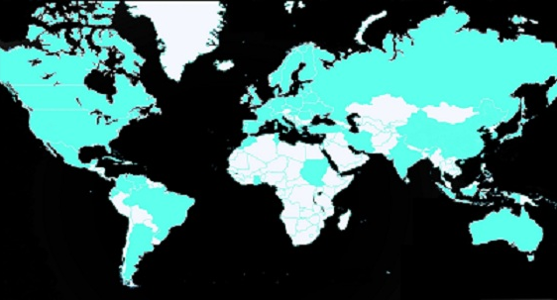
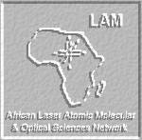
ICO Membership
53 Territorial Committee Members
7 International Society Members
As of October 2016
ICO Philosophy
Links with Academy
Links with Industry
Enhance the creation of activities and ideas
Creating a real world network
Local researchers
Engineering
Providing Visibility for Optics & Photonics
Social, economic, political, scientific and education world
www.e-ico.org

Slide 5
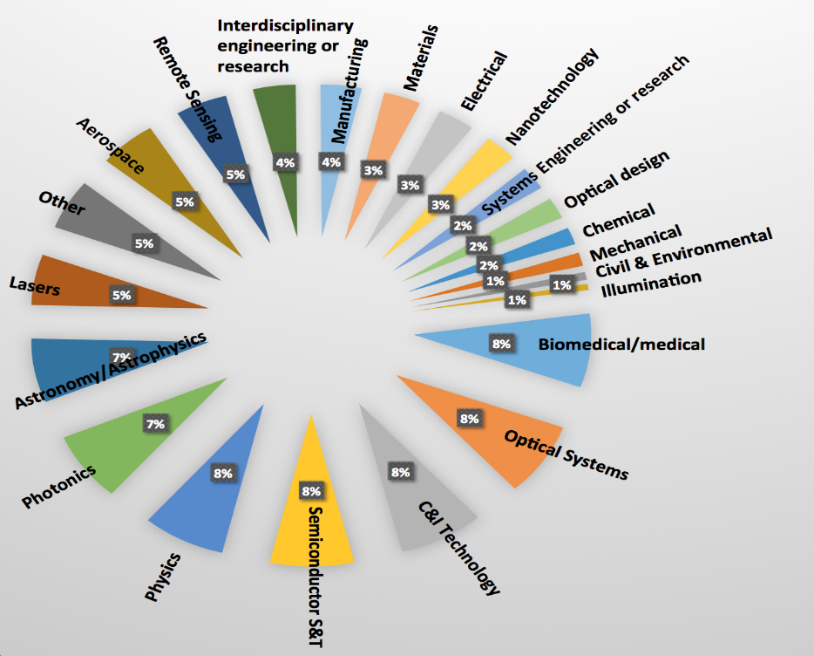
New Frontier of Optics & Photonics
OVERVIEW
Since the discovery of the laser, optical sciences have expanded to incorporate
Frontiers in optics & photonics
Biomedicine
Energy
Climate
Telecommunications
Cultural heritage
Space optics
Computing
Material Processing
Renewable Energy
Health
SPIE data
Example: Data based on primary disciplines within the ICO Society Member, SPIE
www.e-ico.org

Slide 6
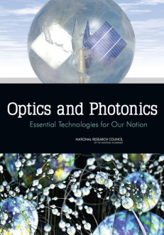
Future Importance of Optics & Photonics
The International year of Light 2015
Provided evidence to scientists, engineers and the general public of the importance and emergence of the field of optics and photonics
US National Photonics Initiative
US National Academy of Sciences
Published the report, ‘Optics and Photonics, Essential Technologies for Our Nation’ with essential information on the current state of optical science and engineering in the US
Photonics21
The European Technology Platform Photonics21 represents the photonics community of industry and research organizations.
Its members develop a common photonics strategy for future research and innovation in Europe
www.e-ico.org

Slide 7
Evolution toward an ICSU Union
Tentative name
International Union for Optics and Photonics (IUOP)
Members
National Members
International Society Members
Associate Members
www.e-ico.org

Slide 8
Objective of IUOP
ICO joining ICSU as a Union is an opportunity to contribute toward the solutions of global challenges in a cross-disciplinary way
To contribute to the progress of the science of Optics and Photonics and their applications on an international basis
To emphasize the unity of the cross-disciplinary field of Optics and Photonics ranging from exploratory science to engineering
To promote international co-operation and facilitate the rapid exchange of information
www.e-ico.org

Slide 9
Current Relationship IUPAP & ICO
ICO is an Affiliated Commission of IUPAP
Affiliated Commission is defined as a group of scientists outside of the Union, recognized by General Assembly (IUPAP Statutes)
ICO sends associate members to two IUPAP Commissions (C15 and C17)
IUPAP sends a contact as the IUPAP Executive Council Delegate in ICO Bureau
Prof. Carmen Cisneros Gudiño
(Instituto de Ciencias Fisicas, Mexico)
www.e-ico.org

Slide 10
Proposed Relationship IUPAP & IUOP (ICO)
IUOP plans to establish liaisons to several Unions including IUPAP
Presidents (or Secretary General) are the contacts
IUOP continues to send Associate Members to IUPAP Commissions
Suggested: C13, C15 and C17
IUPAP are welcome to send Associate Members to IUOP Commissions as well
www.e-ico.org

Slide 11
Summary
Optics and Photonics
Identified as key technologies for addressing the challenges of the XXIst Century
Overlap with the disciplines covered by numerous Scientific Unions
physics, mathematics, biomedicine, chemistry, environmental science, and more
IUOP will
Contribute to sustainable development together with IUPAP and other related ICSU Unions through science and technology of Optics and Photonics.
Act as a seed to extend the associated technologies in developing countries
Encourage entrepreneurship and initiatives for technological companies and education programs
www.e-ico.org

